Slide 1
Lecture 7: Inverse problems and the story of DNA
Today’s plan
An overview of inverse problem
The story of the discovery of DNA

Slide 2
What is an inverse problem?
Usually in mathematics classes we ask you to find a solution to an equation
For an inverse problem, we give you the solution to an equation and ask you to find the equation
Not a well-defined question, but understanding limitations often leads to new mathematics!
Notes:
(or some aspect of the equation)

Slide 3
Example: multiplication
Forward problem: multiply two integers a and b to get n
Inverse problem: given an integer n, factorize it into a and b
Inverse problem does not have a unique solution (e.g. 24 = 8*3 = 4*6 = 12*2 = 1*24)
However, this also leads to interesting mathematics by itself (e.g. prime numbers)

Slide 4
Examples
Find a polynomial of degree n which has a root at x = 2
Find a differential equation whose solution is x(t) = e^{t}
Given two points in a plane, find a circle that passes through the two points

Slide 5
Examples
Can you solve for the integrand?
What if the integrand attains its maximum at x = ½?

Slide 6
Sequences: what rule generates the following sequences?
1, 2, 4, 8, 16, 32, 64, 128, 256, …
Powers of 2:
1, 3, 6, 10, 15, 21, 28, 36, 45, 55, …
Triangular numbers:

Slide 7
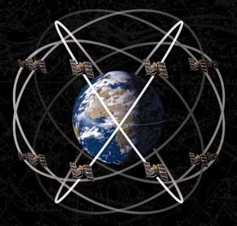
Practical example: GPS
Measure the distance to each satellite
Given the distance, know that the receiver lies on a sphere centered at the satellite
Each satellite corresponds to a different sphere
Receiver is located at the intersection of a point of the spheres
How many are needed?

Slide 8
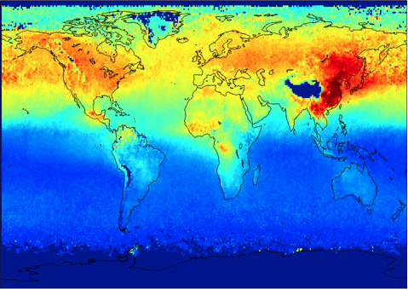
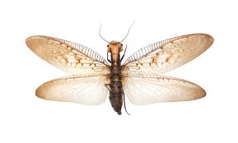
More practical examples
Atmospheric pollution monitoring
Where is the pollution originating, given satellite measurements of chemical composition?
The flying insect
Can smell food but cannot see it. How should it move to find the source of food?

Slide 9
Break

Slide 10
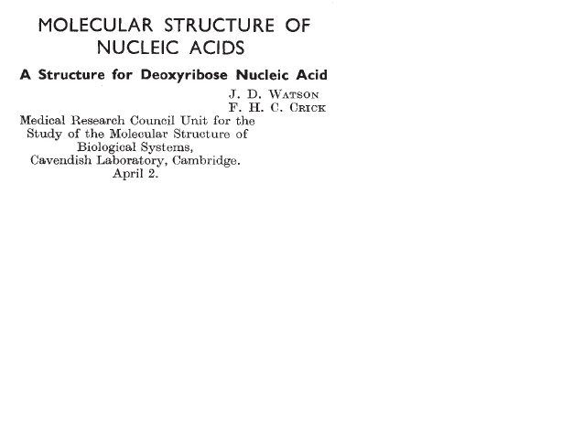
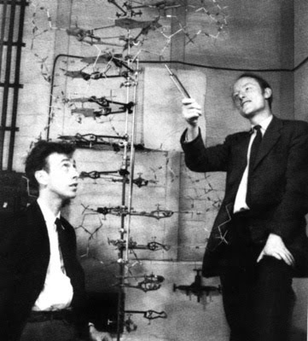
1952 Nobel Prize for Physiology and Medicine
James Watson, Francis Crick, and Maurice Wilkins

Slide 11
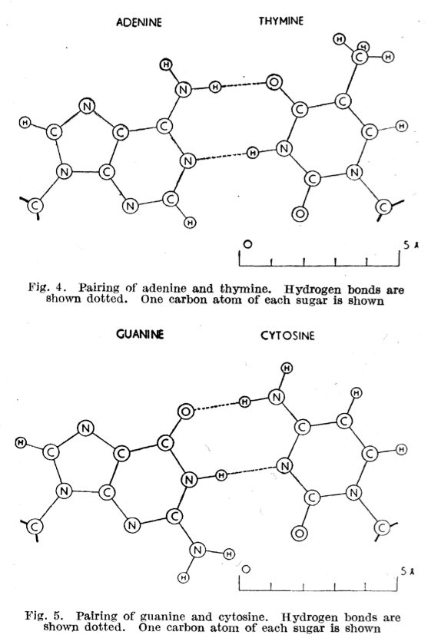
Motivation
1944 paper by Avery, MacLeod and McCarty shows that DNA is the material of inheritance
Watson and Crick realized from model building that A–T and C–G have the same area and shape
Early 1950’s: what structure could support these units?

Slide 12
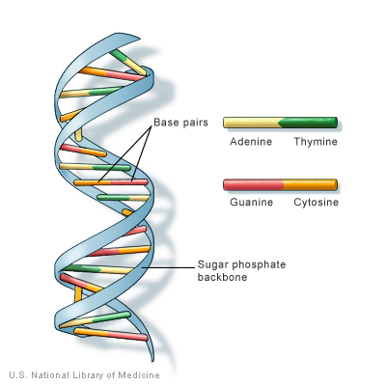
What structure?
Notes:
Data informed this … by data

Slide 13
X-ray diffraction
It is not possible to see DNA directly; it is too small.
To see something, the wavelength of light must be much smaller than the size of the object. This is not true with DNA.
But it is possible to see the diffraction pattern made by DNA using light rays with very small wavelength—X-rays.

Slide 14
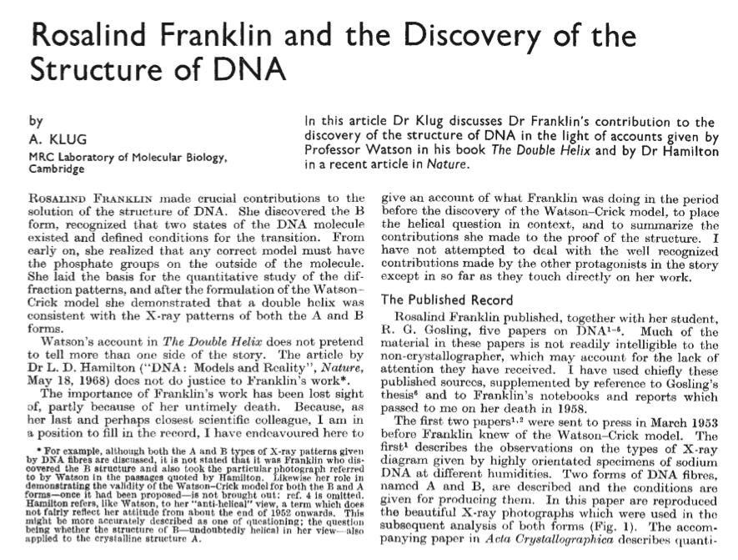

Slide 15
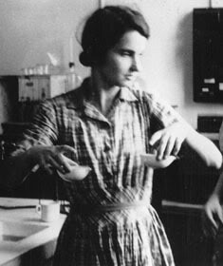
1958
Birkbeck College
DNA papers in Nature
King’s College
Pauling’s helical protein
Paris
Schrodinger
What is Life?
University of
Cambridge
Battle of Britain
St. Paul’s School
“If ever you hear of anybody anxious for the services of a physical chemist who knows very little about physical chemistry but a lot about the holes in coal, please let me know.”
– Franklin to A. Weill, 1945
Credit: Prof. Rafael Jaramillo
1920
Notes:
St Paul’s (1932-1938), Cambridge (1938-1847), Paris (1947-1951), King’s (1951-1953), Birkbeck (1953-1958)

Slide 16
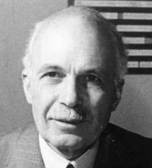
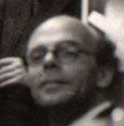
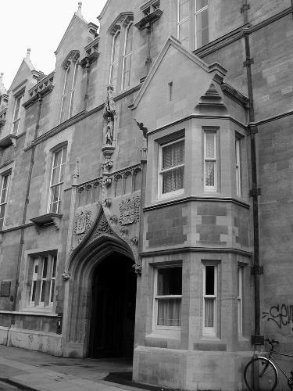
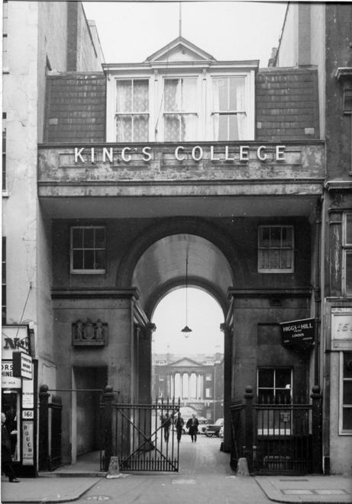
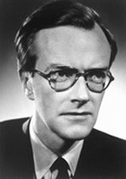
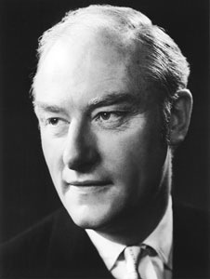
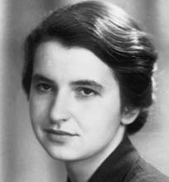

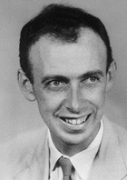
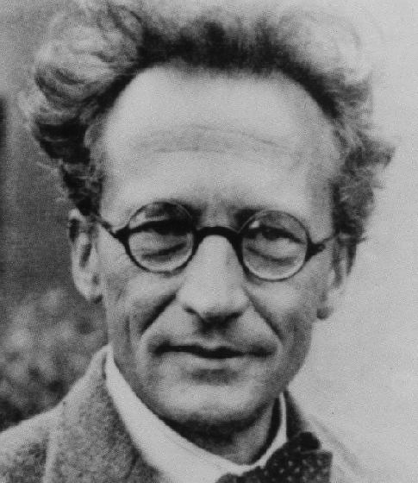
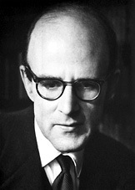
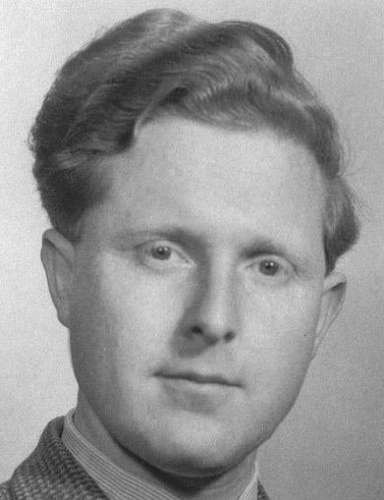
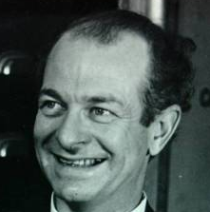

Bragg
Randall
“This means that as far as the experimental x-ray effort is concerned there will be at the moment only yourself and Gosling”
– Randall to Franklin, 1951
Crick
Wilkins
Watson
Schrodinger
Perutz
Pauling
Gosling
Credit: Prof. Rafael Jaramillo

Slide 17
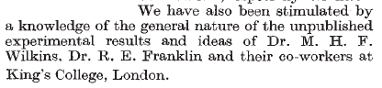
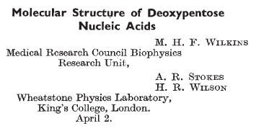
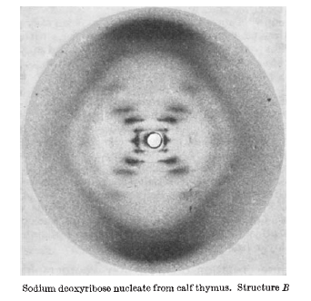
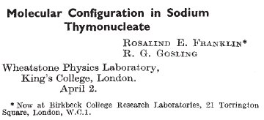

Slide 18
“She needed a collaborator, and she didn’t have one. Somebody to break the pattern of her thinking, to show her what was right in front of her, to push her up and over.”
– A. Klug on Franklin

Slide 19
Photograph 51
Notes:
X ray diffraction pattern of b-dna labelled by franklin as photo 51. diameter of largest circle is 94mm.

Slide 20
Standout features?

Slide 21
Math tool: Fourier Transform
What is a Fourier transform?
Output
“Frequency space”
Input
“Real space”

Slide 22
Sine and Cosine
(Boardwork discussion)
Period is inversely proportional to frequency

Slide 23
Fourier Transform Sine and Cosine
(Boardwork discussion)
High intensity spots signify a repeating pattern

Slide 24
Diffraction pattern: frequency space
Notes:
X ray diffraction pattern of b-dna labelled by franklin as photo 51. diameter of largest circle is 94mm.

Slide 25
Patterns and length scales

Slide 26
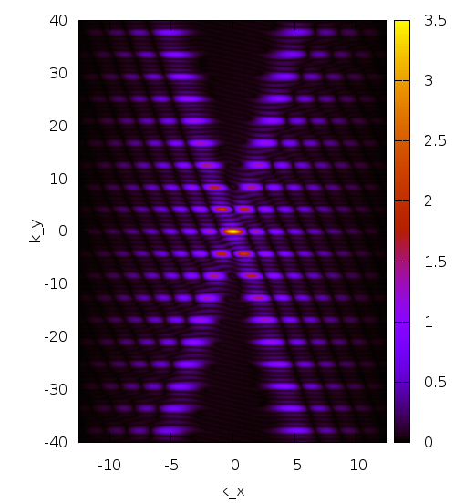
Fourier Transform: single helix
Single helix

Slide 27
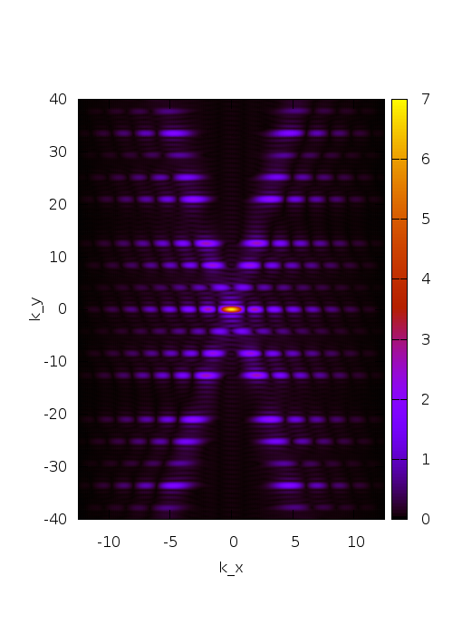
Fourier Transform: double helix
Two helixes with 3/8 displacement
Missing band as in Franklin’s image

Slide 28
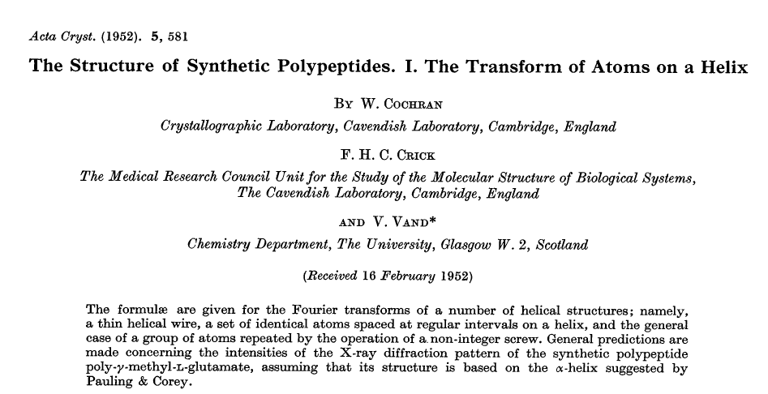
The Calculation of the Century

Slide 29
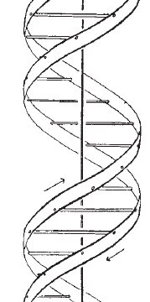
Diffraction from a double helix
Base pair spacing along the helix given by strong reflections at the poles.
Two helices, each with radius R and pitch P, separated by fraction f of P. Destructive interference with f ≈ 3/8 causes missing 4th Bessel line.
Photo 51 gives helix pitch, angle, radius and radial mass distribution, base pair spacing, and double helix separation.
P
fP

Slide 30
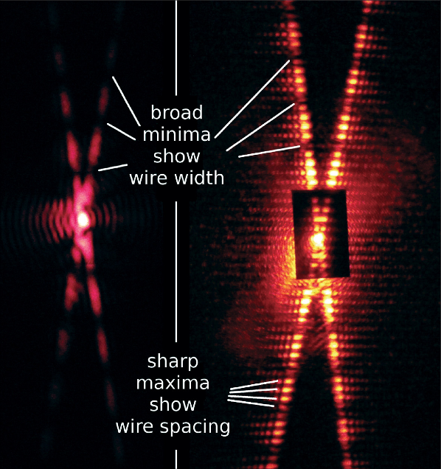
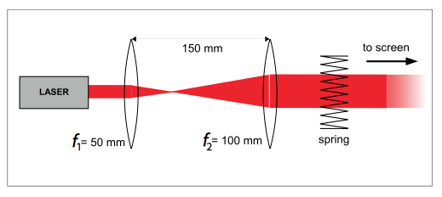
Recreation of experiment
The basic idea behind the experiment can be reproduced with a laser, beam expander, and spring from a ballpoint pen
G. Braun, D. Tierney, and H. Schmitzer, The Physics Teacher 49, 140–143 (2011).

Slide 31
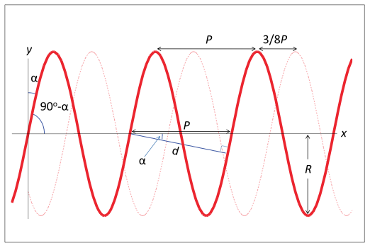
Numerical recreation
The diffraction pattern can also be reproduced by taking the Fourier transform of a helix, which could be approximated by
Notes:
To construct second helix, add a displacement of 3P/8

Slide 32
Thursday’s class
More inverse problems
Computed tomography and image reconstruction

